Slide 1

CS 2110 - Lab 17
Intro to Malloc Implementation
Wednesday 4/13/2022

Slide 2
Homework 9
Apply dynamic memory
Due Friday 4/15 at 11:59 PM
Files available on Canvas
Submit on Gradescope (unlimited submissions)
Standard grace period applies
Extensions for non-emergency/non-medical reasons are not possible on HW9 or HW10.

Slide 3
Homework 10 – Malloc Implementation
Write your own malloc and free!
Releases Monday 4/18
Due Tuesday 4/26 at 11:59 PM
Files available on Canvas
Submit on Gradescope (unlimited submissions)
Standard grace period applies
Extensions for non-emergency/non-medical reasons are not possible on HW9 or HW10.

Slide 4
Timed Lab 4
Next Monday 4/18 during lab
You must come to class and take the TL here
Open book, open note, open internet
Use one device only: transfer any notes to your laptop
No communication with anyone else except your TA(s)
Full 75 minutes to complete the TL!
Will cover HW7, HW8 and HW9

Slide 5
Timed Lab 3
One-off opportunity to get points back
Due Saturday 4/16/2022 at 11:59PM
New grade is average of new and old
Can’t go down
Can’t post on Ed or ask TAs

Slide 6
Unions

Slide 7
What are they?
Declared like structs
Mean something completely different
All elements share the same memory
Changing one changes the others

Slide 8
Example
union punner {
int x;
short y;
char z;
};
x = 0xCAFEBABE
y = 0xCAFE
0xCA
0xFE
0xBA
0xBE
z = 0xCA

Slide 9
“Out” Parameters

Slide 10
"Out" Variables
How do you return multiple values from a function?
Could use structs with one member for every return value
Adds lots of boilerplate
Need a new struct for every function
Can get confusing (need to go to the declaration to see what types are contained)

Slide 11
"Out" Variables
Solution: pass in a pointer to a local variable in the calling function!
Pick one type as your "main" return value
Return the rest of the values by writing to "out" variables
int main(void) {
char *s; // hello will write to this
int len = hello(&s);
// now 's' is "hello"
...
}
// Returns a string along with its length
int hello(char **out) {
char *c = "hello";
return strlen(c);
}
Caller passes a pointer to a local variable
Callee uses the pointer to modify the caller's local variable

Slide 12
"Out" Variables
Why doesn't this work? How can we fix it?
// Returns a string along with its length
int hello(char **out) {
char *c = "hello";
out = &c; // doesn't work!
return strlen(c);
}

Slide 13
"Out" Variables
Changing the value of out rather than *out just modifies our own stack frame, not the caller's
// Returns a string along with its length
int hello(char **out) {
char *c = "hello";
*out = c;
return strlen(c);
}

Slide 14
Malloc Implementation

Slide 15
Malloc & Friends
malloc(size): allocates size bytes on the heap
calloc(nmemb, size): allocates nmemb*size bytes on the heap and zeroes them out
realloc(ptr, size): the “resize” function; returns a block of size bytes with the data from ptr
These functions return a void* to the new block, or NULL on failure

Slide 16
Free
free(ptr): Gives a pointer returned by malloc (or friends) back to the heap; we no longer need it
Never use a freed pointer, it is no longer valid.
Failing to free pointers you’re not using will cause memory leaks; the heap will run out of space
realloc(ptr,size) will also free ptr, so you should use the pointer returned instead

Slide 17
What do we need to do?
Our implementation of the malloc library must:
Give out free memory as requested
Take memory back when it’s freed
Request more free memory from the operating system when we don’t have enough
How can we keep track of our free memory?

Slide 18
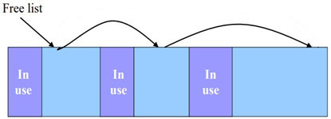
The Freelist!
We need a way to keep track of available memory, which could be all over the heap
Solution: a linked list of all available memory blocks
Specifically, blocks that are NOT currently allocated

Slide 19
The Freelist!
When malloc() is called, we search through freelist to find block of adequate size to return to the user
How do we know the size of each block in memory?

Slide 20
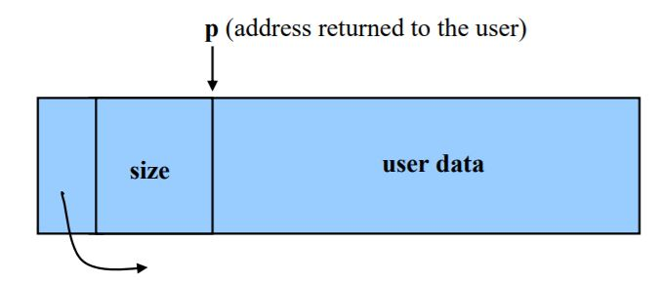
Metadata
Each block has “metadata”—useful information about the block
We need to keep track of size of the block (why?)
We also need a pointer to the next node in the list
The address returned to user is after the metadata

Slide 21
Malloc Implementation
With the freelist, we are ready to see how malloc works:
User asks for block of certain size
​​malloc looks through freelist for this size
If we find such a block, remove it from the freelist and return it to the user!

Slide 22
Malloc Implementation
What if we don’t find a block of the right size?
If we have a block greater than the size:
Divide the block into two parts, one of the correct size, and one with whatever’s left over
Remove and return new block with proper size
What if we don’t have any blocks that are big enough?

Slide 23
Malloc Implementation
sbrk()
System call that gives us a large chunk of heap space to work with
We can add this new block to freelist and continue
sbrk returns -1 in case of error
If this occurs, we have run out of heap space
We should simply return NULL

Slide 24
Other functions
How can we free a block?
Can we implement calloc() and realloc()?
Don’t reinvent the wheel – use malloc() and free() in your implementations of these functions!

Slide 25

Lab Assignment: Canvas Quiz
Go to Quizzes on Canvas
Select Lab 17
Access code: sbrk
Get 100% to get checked off!
Unlimited attempts
Collaboration is allowed!
Ask your TAs for help :)

